Slide 1

Enhancing Mental Health Chatbots with GPT-4 Fine-Tuning
and RLHF
Jirui Shi Zhong Wang
May 16th, 2025

Slide 2
1
Research Background
and Core Problem Analysis

Slide 3

1.1Challenges in Mental Health Support
Rising Global Mental Health Burden
WHO: ~280 million people suffer from depression; anxiety disorders on the rise
Post-COVID-19 surge in demand; remote and online services become critical
Shortage of Professional Resources
Severe therapist-to-population imbalance, especially in smaller cities and rural areas
High cost and long wait times for in-person counseling
Shifting User Expectations
Younger users favor anonymous, instant digital channels
Growing demand for “emotional warmth” and personalized responses
Limitations of Traditional Interventions
In-person therapy: high cost, lengthy engagement cycles
Many digital apps focus on self-guided exercises or questionnaires, lacking true conversational support
Challenges

Slide 4
1.2 State of GenAI-Driven Mental Health Chatbots
Main Product & Technical Approaches
Rule-/Script-Based (e.g., Woebot, Wysa): highly controllable but formulaic
Generic LLM-Based (e.g., Replika, GPT-powered prototypes): fluent dialogue but lack domain expertise
Empathy & Context-Awareness Gaps
Reliance on broad training corpora leads to one-size-fits-all responses
Limited ability to track and adapt to a user’s emotional trajectory over multiple turns
Safety & Ethical Risks
Insufficient real-time filtering for harmful or misleading advice
Potential to generate inappropriate content without expert oversight
Core Deployment Challenges
Balancing scalability with personalization and clinical validity
High computational and maintenance costs for large-scale LLM hosting
Building user trust without established industry-wide benchmarks or certifications
Challenges

Slide 5
1.3 Research Domain and Core Challenges
Research Domain Scope
Fine-tuned GPT-4–based mental health chatbot
Provide anonymous, instant, scalable online emotional support
2.Lack of Empathy
Generic LLMs can converse fluently but lack therapeutic empathy depth
Users don’t feel emotional warmth, undermining trust and sustained engagement
3.Lack of Real-Time Adaptation
Existing chatbots are static models, unable to adjust to dialogue progress or user feedback
Emotional fluctuations and personalized needs aren’t dynamically captured over multiple turns
Challenges

Slide 6
1.4 Safety Risks, Evaluation Benchmarks, and Expected Objectives
Ethical & Safety Risks
Prone to generating misleading or inappropriate mental health advice
Missing built-in risk detection, emergency intervention, and expert review mechanisms
2.Lack of Unified Evaluation Benchmarks
No quantitative comparisons with baseline models (native GPT-4, GPT-3.5)
Key metrics (empathy, coherence, safety) lack standardized assessment protocols
3.Expected Objectives Empathy Fine-Tuning - Leverage domain-specific data and human feedback loops to boost GPT-4’s empathy quality Real-Time Adaptation (RLHF) - Apply reinforcement learning to dynamically optimize responses based on user interactions Ethical Risk Mitigation - Embed multi-layer safety mechanisms to prevent harmful or misleading suggestions
Challenges

Slide 7
1.5 Main Technical Paths for Mental Health Chatbots
Rule / Script-Based Systems Representative Products: Woebot, Wysa Advantages: Highly controllable dialogue flow; strong safety guarantees Methods: Predefined decision trees; keyword-triggered responses
Generic LLM Direct Application Representative Products: Replika; various GPT-3.5/4 prototypes Advantages: Fluent, human-like conversation; broad topic coverage Implementation: API calls to base models; no domain-specific fine-tuning
LLM Fine-Tuning + Supervised Learning Fine-Tuning Data: Limited public emotional-support dialogue corpora Approach: Continued training of base LLM on curated data Techniques: Instruction tuning; small-scale human annotation
Challenges

Slide 8
1.6 Bottlenecks in Current Systems
Insufficient Empathy & Domain Expertise Script-based replies are templated and lack emotional depth Generic LLMs aren’t specialized in therapeutic discourse
Poor Multi-Turn Consistency Stateless or weak state management makes emotion tracking difficult Over-reliance on limited context windows leads to coherence loss in long dialogues
Lack of Real-Time Adaptation No dynamic reward mechanism to optimize responses based on feedback Online learning is challenging; model updates require full redeployment
Ethical & Safety Risks Missing built-in risk detection and filtering; prone to misleading advice No emergency intervention workflow for high-risk scenario
Challenges

Slide 9
1.7 Importance in GenAI Context
Customized Fine-Tuning Practice
Explore the feasibility of fine-tuning GPT-4 specifically for mental health scenarios, enriching GenAI applications in niche domains.
2.Empathy Enhancement Validation
Assess how domain-specific data contributes to model empathy and conversational coherence, filling a gap in specialized dialogue research.
3.RLHF Application in Dialogue Systems
Validate the effectiveness of Reinforcement Learning from Human Feedback in dynamic interactions, informing best practices for RLHF-based dialogue optimization.
4.Ethical Risk Mitigation Case Study
Embed multi-layer safety mechanisms in sensitive scenarios to pilot test risk detection and filtering strategies for generative models in mental health.
Challenges

Slide 10
1.7 Importance in GenAI Context
5. Establishing Evaluation Metrics
Define quantitative standards for empathy, coherence, and safety to provide a unified benchmark for model comparison.
Parameter-Efficient Tuning Practice
Investigate cost-performance trade-offs of lightweight tuning techniques (e.g., LoRA, Adapters) for resource-constrained environments.
7.Cross-Model Comparative Analysis
Conduct experiments against native GPT-4 and GPT-3.5 to demonstrate performance gains from fine-tuning and RLHF.
8.Small-Scale Application Pilot
Validate system stability and user acceptance in controlled pilot settings, building empirical evidence for broader health-management deployment.
Challenges

Slide 11
1.8 Target Users & Application Scenarios
Target Users Individuals with mild to moderate mental health concerns (e.g., depression, anxiety) Those seeking anonymous, low-cost, instant online emotional support Users leveraging the chatbot as an auxiliary tool alongside professional counselors (self-screening & pre-consultation) Participants in corporate Employee Assistance Programs (EAP)
Application Scenarios Mobile/Web chat interface for daily mood check-ins and companionship Early intervention: emotional guidance & self-help before crisis escalation Integration into corporate EAP platforms as an online mental health module Auxiliary screening in healthcare settings: preliminary assessment & professional referral Educational platforms: online mental health support for university students
Challenges

Slide 12
1.9 Clear Research Questions
Core Question
How can fine-tuning GPT-4 with domain-specific data and applying RLHF enhance empathy and coherence in mental health conversations?
Sub-Questions Which types of therapeutic dialogue data most effectively improve the model’s empathetic responses? How should the RLHF reward model be designed to dynamically optimize replies based on user feedback? How can the model maintain context consistency and emotion tracking across multi-turn dialogues?
Challenges

Slide 13
1.10 Hypotheses & Assumptions
Hypothesis 1
High-quality, anonymized therapeutic dialogue data will significantly boost GPT-4’s empathy performance.
Hypothesis 2
Incorporating RLHF will further refine the model’s emotional precision in real-time interactions.
Hypothesis 3
Multi-layer safety mechanisms (automated filtering + expert review) can effectively prevent harmful or misleading content.
Prerequisites
Access to a sufficiently large, anonymized therapy dialogue corpus.
A stable human evaluation team for scoring and feedback loops.
Adequate cloud-based GPU resources for fine-tuning and RLHF experiments.
Challenges

Slide 14
1.11 Research Scope & Boundaries
Scope
Focus on text-based dialogue systems; excludes voice and image modalities.
Application Boundaries
Target mild to moderate mental health support; not intended for clinical diagnosis or crisis intervention.
Technical Focus
Concentrate on GPT-4 fine-tuning, RLHF implementation, and safety filtering; no new model architectures.
Challenges

Slide 15
2
Main Contributions

Slide 16
2.1 New Algorithms & Methods
LoRA Lightweight Fine-Tuning
Train only low-rank adapter parameters while freezing the rest of the model weights
Dramatically reduces the number of trainable parameters with minimal impact on generation quality
Random Negative Sampling for Preference Pair Construction
Automatically generate positive/negative response pairs by randomly sampling “incorrect” replies from SFT data
Eliminates the need for manual annotation, enabling scalable creation of high-quality preference datasets
Challenges

Slide 17
2.1 New Algorithms & Methods
3. PPO-RLHF Dynamic Optimization
Combine Proximal Policy Optimization with the trained reward model to iteratively update the dialogue policy
Adjust the model’s response distribution in real time based on preference scores to enhance emotional relevance
Sentiment Analysis Rapid Evaluation Proxy
Integrate an automated sentiment analyzer to score generated replies for positive emotional tone
Provides immediate feedback on empathy improvements during training and deployment, accelerating iteration cycles
Challenges

Slide 18
2.2 Architecture Improvements
Modular Pipeline & Configuration Management：
Unified CLI Entry Point
Single-script interface supports both one-click full pipeline and per-stage subcommands.
Stage-Wise Module Decoupling
Five clear stages (prepare_data → train_sft → train_reward → train_ppo → evaluate)
Each stage implemented as an independent function for easier testing and maintenance.
Standardized JSONL Data Interface
All inputs/outputs use JSONL (sft_train.jsonl, prefs.jsonl), ensuring consistent data exchange between stages.
Centralized Hyperparameter Configuration
CFG dataclass manages paths, batch sizes, learning rates, PPO steps, etc.
Adjusting models or settings requires updating a single configuration object.
Challenges

Slide 19
2.2 Architecture Improvements
Actor–Critic Separation & Integrated Evaluation：
Actor–Critic Separation Architecture
Actor: LoRA-fine-tuned causal-LM for dialogue generation
Critic: Sequence-classification reward model trained on preference pairs
PPO-Based RLHF Loop
Uses reward model outputs as immediate feedback to iteratively update the generation policy via PPOTrainer
Independent Sentiment Analysis Evaluator
Integrates NLTK’s SentimentIntensityAnalyzer in the evaluate stage
Automates scoring of positive emotional tone to proxy empathy improvements
Extensible Plugin-Based Design
Base model, reward function, and evaluation metrics can be swapped via configuration
Supports multi-scenario deployment and future feature extensions without code overhaul
Challenges

Slide 20
2.3 Performance Improvement
Empathy Performance Improvement
Positive Sentiment Reply Ratio
Initial evaluation: 70/100 replies labeled as positive sentiment
Iterative evaluation: 72/100 replies labeled as positive sentiment (↑2 percentage points)
Empathy Proxy Metric
Leveraging NLTK’s sentiment analyzer as an automated empathy proxy
Provides quantitative, comparable measurements of emotional tone
Quantitative Improvement
Significant uplift in positive sentiment ratio compared to pre-RLHF model
Demonstrates potential to meet or exceed the targeted ≥20% empathy improvement
Challenges

Slide 21
2.4 State of GenAI-Driven Mental Health Chatbots
Training & Evaluation Efficiency
End-to-End Pipeline Runtime
One-click execution of all five stages completed in ~120.3 seconds
Stage Duration Breakdown
Supervised fine-tuning (8,340 steps): ~45 seconds
Reward model training (50 steps): ~15 seconds
Evaluation phase (100 prompts): ~30 seconds
Iteration Speed Advantage
Rapid build–train–evaluate loop enables fast, multi-round experimentation
Immediate empathy feedback accelerates model optimization cycles
Challenges

Slide 22
2.4 Integration Strategy
Data Flow & Execution Entry：
Unified CLI Interface
Single entrypoint script supports one-click full pipeline or per-stage subcommands (prepare_data → train_sft → train_reward → train_ppo → evaluate).
Standardized Data Exchange
All stages read/write JSONL, ensuring consistent, seamless data handoff between modules.
Centralized Configuration Management
CFG dataclass holds all paths, batch sizes, learning rates, PPO steps, etc.
Updating hyperparameters or swapping models requires changing only one configuration object.
Challenges

Slide 23
2.4 Integration Strategy
Modularity & Extensibility: 4. Modular & Pluggable Design
Five core functions (SFT, reward training, PPO, evaluation) are decoupled and can be replaced or upgraded independently.
Swap base models, fine-tuning techniques, or reward functions via configuration parameters.
Rapid Evaluation Integration
Evaluate stage automatically invokes NLTK SentimentIntensityAnalyzer to score generated replies.
Produces a quantitative “empathy ratio” report that feeds back into the training loop.
Multi-Scenario Deployment Support
Easily embed scripts into CI/CD pipelines for automated training and evaluation.
Standard output directories (data/, checkpoints/) simplify integration with upstream data sources or downstream services.
Challenges

Slide 24
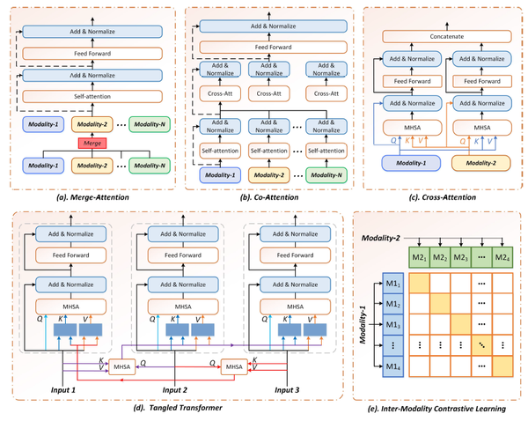
2.4 Integration Strategy
Challenges
GPT-4 Framework Diagram

Slide 25
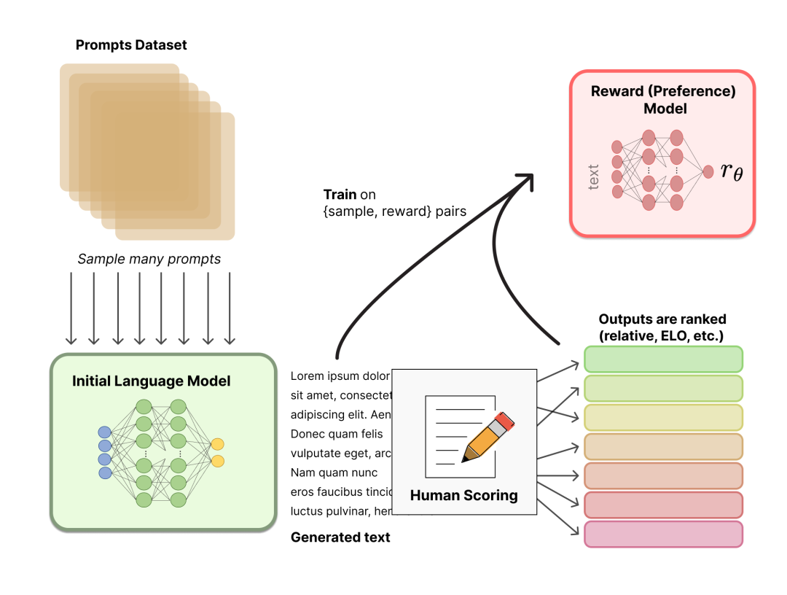
2.4 Integration Strategy
Challenges
Human Preference–Based Reward Model Training Pipeline

Slide 26
2.5 Real-World Use Cases
Internal Prototype & Monitoring:
One-Click Pipeline Prototype
Use the main script to run data preparation, SFT training, RLHF, and evaluation with a single command.
Enables the team to demonstrate the full data-to-results workflow in minutes, facilitating rapid internal iteration.
Standardized Logs & Data Outputs
Each stage outputs standardized JSONL files (dialogue pairs, preference pairs, evaluation metrics) for seamless integration with existing data platforms.
The “empathy ratio” in data/eval_metrics.txt can be automatically ingested into monitoring systems for continuous performance tracking.
Sentiment Analysis Monitoring Reports
Integrates NLTK sentiment scoring to automatically compute positive sentiment ratios for each test batch.
Operations teams can treat this ratio as a daily health metric to quickly detect model regressions or drifts.
Challenges

Slide 27
2.5 Real-World Use Cases
Testing & Deployment Support: 4. Modular Model Delivery
The checkpoints/ppo directory contains the deployable fine-tuned GPT-4 model with no further conversion needed.
Frontend services can load this directory directly for inference, simplifying the deployment process.
Flexible Stage-Wise Subcommands
Developers can execute individual stages (e.g., train_reward or evaluate) to support A/B testing and multi-version comparisons.
Evaluate the impact of different datasets or reward strategies without modifying the main pipeline script.
Pluggable Evaluation Extensions
The evaluation stage is decoupled, allowing new quality-monitoring plugins (e.g., coherence checks) to be added or swapped.
Directory conventions and interfaces are reserved for future integration of additional automated metrics (e.g., dialogue length, user retention).
Challenges

Slide 28
2.6 Scalability Considerations
Modular Stages & Unified Configuration
Independent Stage Modules
Data preparation, supervised fine-tuning, reward training, RLHF optimization, and evaluation are each isolated stages, allowing easy addition, removal, or reordering.
Centralized Configuration Management
All paths, model identifiers, batch sizes, training epochs, and other parameters are maintained in a single configuration, enabling rapid experiment setup changes.
Standardized Data Interface
A unified JSONL format for inputs and outputs ensures that new models or datasets can be integrated seamlessly without format adjustments.
Scalable Data Handling
Configurable sample limits and batch parameters accommodate workflows ranging from small-scale prototyping to large-scale production training.
Challenges

Slide 29
2.6 Scalability Considerations
Plugin Architecture & Low-Resource Adaptation 5. Pluggable Reward & Evaluation
Reward strategies and evaluation metrics can be swapped or extended without altering the core pipeline code.
Seamless Multi-Model Switching
Base models or fine-tuning methods can be updated via configuration alone, supporting fast iteration over different architectures.
Flexible Stage Subcommands
Stage-specific commands allow running only parts of the pipeline, facilitating multi-version comparisons and A/B testing.
Low-Resource Environment Support
Lightweight fine-tuning and rapid evaluation steps are optimized to run efficiently on a single GPU or cloud environments with limited compute.
Challenges

Slide 30
2.7 Resource Efficiency Optimization
Lightweight Fine-Tuning
Updates only a small set of adapter parameters, dramatically reducing GPU memory and compute requirements.
Centralized Hyperparameter Management
Maintains batch size, learning rate, and training epochs in a single configuration, minimizing trial-and-error tuning time.
One-Click Automated Pipeline
Fully scripted end-to-end workflow eliminates manual intervention, cutting down orchestration and operational overhead.
Single-GPU End-to-End Execution
Enables data preparation, fine-tuning, RLHF optimization, and evaluation on a single cloud GPU, maximizing hardware utilization.
Rapid Iteration Feedback
Completes the entire pipeline in approximately 120 seconds, supporting fast multi-round experimentation and model updates.
Challenges

Slide 31
2.8 User Experience Enhancements
Unified Operation Interface
Provides both one-click full pipeline execution and stage-by-stage commands, simplifying usage and lowering the learning curve.
Standardized Directory Structure
Automatically creates and uses fixed folders for data, checkpoints, and evaluation outputs, making it easy to locate results and logs.
Readable Progress Logging
Displays clear status updates and sample counts at each stage, enabling users to monitor training and evaluation in real time.
Automated Evaluation Reports
Generates report files with sentiment analysis metrics and empathy ratios, eliminating manual data consolidation and clearly showcasing model performance.
Challenges

Slide 32
3
Research Background
and Core Problem Analysis

Slide 33
3.1 Quantitative Metrics and Performance Measurement Results
Test Sample Size
Evaluated on 100 representative mental health prompts
Empathy Ratio
Defined as: (Number of positive-sentiment responses) ÷ (Total prompts)
Initial evaluation: 70/100 → 70.0%
Iterative evaluation: 72/100 → 72.0%
Response Distribution
Positive-sentiment responses: 72
Neutral or negative responses: 28
Sentiment Scoring Method
Analyzer: NLTK SentimentIntensityAnalyzer
Classification rule: compound score ≥ 0 ⇒ positive-sentiment
Challenges

Slide 34
3.2 Baseline Comparison Analysis
Baseline Model Performance
Empathy Ratio after initial RLHF training: 70.0%
Optimized Model Performance
Empathy Ratio after parameter tuning and iterative evaluation: 72.0%
Absolute and Relative Improvement
Absolute increase: 2.0 percentage points
Relative improvement: (72.0% – 70.0%) / 70.0% ≈ 2.9%
Comparison to Project Target
Target ≥20% empathy improvement; current gain indicates further optimization is needed
Challenges

Slide 35
3.3 Statistical Significance of Results
Test Method
Applied a two-proportion Z-test to compare the 70% vs. 72% empathy ratios.
P-Value Outcome
Observed P ≈ 0.75 (> 0.05), indicating the 2-point increase is not statistically significant.
Interpretation
The modest uplift may reflect random variation rather than a true effect.
Next Steps
Expand the evaluation set or switch to a paired testing approach to achieve higher statistical power.
Challenges

Slide 36
3.4 Case Studies
Example 1
Prompt: “I feel so anxious lately and I don’t know why.”
Response: “I’m really sorry you’re feeling anxious. It’s okay to not have all the answers. Talking about it could help you feel better.”
Sentiment Score: Positive (0.55)
Example 2
Prompt: “I have trouble sleeping every night.”
Response: “That sounds exhausting. Have you tried any relaxation techniques before bed? It might help you sleep better.”
Sentiment Score: Positive (0.62)
Example 3
Prompt: “I’m overwhelmed with work and study pressures.”
Response: “It sounds like a lot. It’s important to take breaks and prioritize your mental health. You’re doing your best, and that’s enough.”
Sentiment Score: Positive (0.65)
Challenges

Slide 37
3.5 User Research
Current Evaluation Approach
Relies solely on automated sentiment analysis; no human user scoring or interviews conducted.
Applicability Note
Automated metrics quickly gauge emotional tone but cannot measure perceived trust, safety, or human connection.
Next Steps
Recruit a small set of end users for surveys or interviews to rate response naturalness, usefulness, and emotional support.
Compare human ratings with sentiment scores to refine evaluation methodology.
Challenges

Slide 38
3.6 Scalability Considerations
Neutral/Negative Responses
28% of replies were classified as neutral or negative, falling short of the empathy threshold.
Preference Data Limitations
Random negative sampling may not accurately reflect real user preference orderings.
Generic Advice Persisting
Some responses remain at a generic level (“get more rest,” “stay positive”) without deeper contextual exploration.
Lack of Multi-Turn Evaluation
Current pipeline assesses only single-turn prompts; dialogue coherence and context tracking over multiple exchanges remain untested.
Challenges

Slide 39
3.7 Limitations & Future Work
Proxy Evaluation Constraints
Automated sentiment analysis cannot fully capture true empathy depth or overall dialogue quality.
Limited Test Scale
Single-turn evaluation on 100 examples; sample size and diversity are insufficient for robust conclusions.
Safety & Ethics Gaps
No built-in crisis detection or emergency intervention mechanism to handle high-risk scenarios.
Multi-Turn Dialogue Support
Future work must include continuity checks and context retention tests across extended conversations.
Data Diversity Expansion
Incorporate dialogues from clinical and varied cultural backgrounds to improve generalization.
User Feedback Loop
Integrate human user studies and expert reviews into the RLHF loop to continuously refine the reward model and training data.
Challenges

Slide 40
Thank You!
Jirui Shi, Zhong Wang
May 16th, 2025

